Slide 1
Lesson 4
Power on VMs for X hours:
Uses runtime parameters
Uses Az module to modify Azure

Slide 2
Lab: Azure Runbook Script
Power on VMs for X Hours
Sometimes it is necessary to have VMs powered on for an extended period, for example when running a centralized patching service once a week.
This script will ensure all hosts in a host pool are powered on for the specified number of hours, regardless of the auto-scale settings.
Notes:
Associate the script with the VM creation in Nerdio

Slide 3
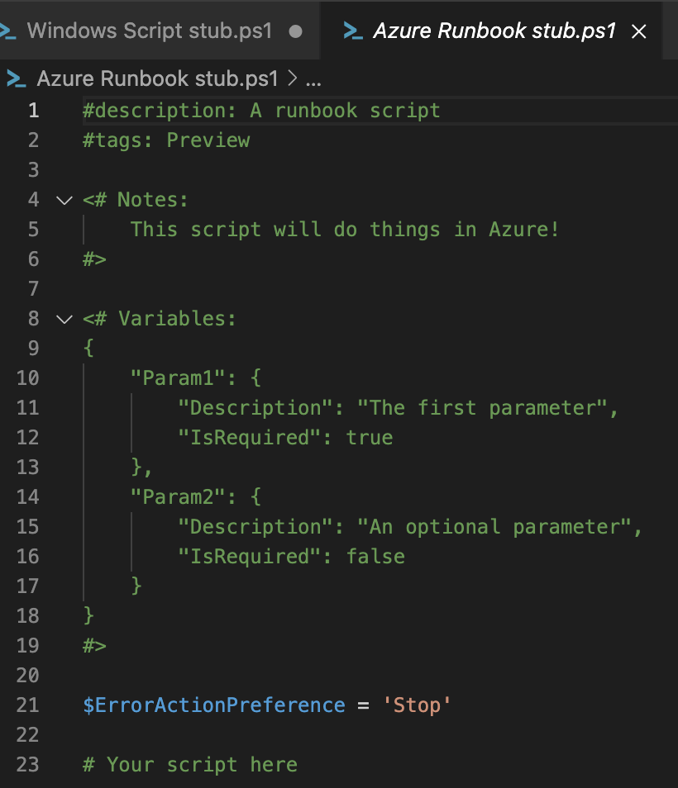
Lab: Azure Runbook Script
Power on VMs for X Hours
Begin by copying the Azure Runbook “Stub” file
Note: The Variables section is json-formatted text that defines the parameters you can provide when running the script. NMM parses this section and provides a UI for entering these values at runtime.
Notes:
Copy stub to new file under runbooks folder

Slide 4
Lab: Azure Runbook Script
Power on VMs for X Hours
This script should accept the following parameters:
HostPoolName: The host pool containing the VMs.
HostPoolResourceGroup: The RG containing the host pool.
Hours: An integer indicating how long the hosts should remain on.
Hint: The stub file illustrates how to define the above parameters.

Slide 5
Lab: Azure Runbook Script
Power on VMs for X Hours
This script will:
Set a tag on all VMs to exclude hosts from scale-in activity for X hours.
Power on all hosts.
Hint: Both of these tasks can be accomplished using the Az module commands.
Notes:
Associate the script with the VM creation in Nerdio

Slide 6
Lab: Azure Runbook Script
Power on VMs for X Hours
Tip:
When developing an Azure runbook script, you can connect to Azure using your own credentials, if your account has permissions to perform the actions required by the script.
Do not add the authentication line to the script itself as Nerdio Manager will take care of authentication for the runbook.
Notes:
Associate the script with the VM creation in Nerdio

Slide 7

Lab: Azure Runbook Script
Power on VMs for X Hours
Tip:
If you defined HostPoolName, HostPoolResourceGroup, and Hours in the variables json section of the script, you should have access to the variables $HostPoolName, $HostPoolResourceGroup, and $Hours in your script.
For testing and development, you can define these variables manually in the console:
Notes:
Associate the script with the VM creation in Nerdio

Slide 8
Lab: Azure Runbook Script
Power on VMs for X Hours
Retrieving the VMs:
You can find all hosts in the host pool using:
Get-AzWvdSessionHost –HostPoolName $HostPoolName -ResourceGroupName $HostPoolResourceGroup
However, the session host’s name and VM name are not the same. You’ll need to derive a list of VM names from the session host names, then retrieve the VMs from Azure using Get-AzVM.
Notes:
Associate the script with the VM creation in Nerdio

Slide 9
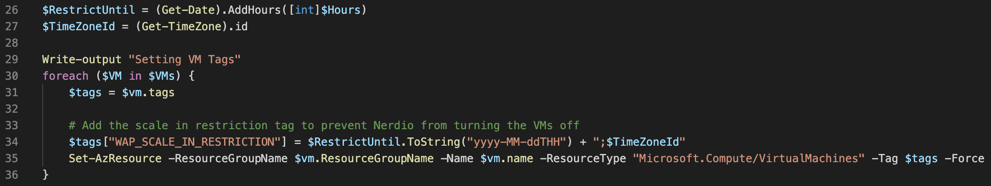
Lab: Azure Runbook Script
Power on VMs for X Hours
Setting a VM tag to exclude from scale-in:
The tag name is ‘WAP_SCALE_IN_RESTRICTION’, and the value needs to be in a specific format:
2024-06-15T08:00;Central Standard Time
Notes:
Associate the script with the VM creation in Nerdio

Slide 10
Lab: Azure Runbook Script
Power on VMs for X Hours
Testing in NMM:
When ready to test your script in NMM, commit the changes to your repository and sync to GitHub. Then, initiate a sync in NMM, and your latest changes will be available in the Scripted Actions section.
Notes:
Associate the script with the VM creation in Nerdio

